Slide 1

Lecture 2.1 Role of chemistry in computer science & engineering Modified by- Tanim Ahmed Lecturer(CSE),DIU Email: tanimahmed.cse@diu.edu.bd

Slide 2

CONTENTS
Uses and effects of chemistry
Benefits of Chemistry
Applications of Chemistry

Slide 3
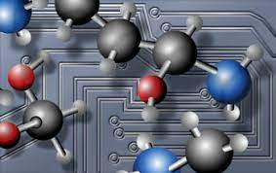
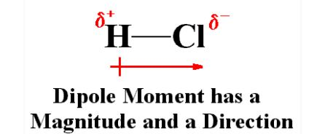
Uses and effects of chemistry
Computational chemistry uses result of theoretical chemistry incorporated into efficient computer programmed to calculate structure and properties of molecule.
It calculate the properties of molecule such as structure, relative energy, charge distribution, dipole moment, vibrational frequency, reactivity and other spectroscopic quantity.
Computational chemistry range from highly accurate (Ab initio method to less accurate (Semi-empirical method) to very approximate (molecular mechanics).
(ab initio and semi-empirical will be discussed later)*
Notes:
A dipole moment is a measurement of the separation of two opposite electrical charges. Dipole moments are a vector quantity. The magnitude is equal to the charge multiplied by the distance between the charges and the direction is from negative charge to positive charge:

Slide 4
Cont.
In the past two decades, computational molecular modeling approaches (Leach, 2001) have emerged as important tools that can be used to predict atomic structure, vibrational frequencies, binding energies, heats of reaction, electrical properties, and mechanical properties of organic and inorganic materials.

Slide 5
Benefits of Computational Chemistry
1) It allows the medicinal chemist to use the computational power of computer for measurement of Mol. geometry , electron density, electrostatic potential conformational analysis, different types of energies etc..
2) Determination of structure of ligand and target through X-ray crystallography and NMR spectroscopy.
3) Docking of ligand in receptor active sites and exact measurement of geometric and energetic favorability of such interaction.
4) Comparison of various ligands through various parameters.
Notes:
A ligand is an ion or molecule, which donates a pair of electrons to the central metal atom or ion to form a coordination complex. The word ligand is from Latin, which means “tie or bind”. Ligands can be anions, cations, and neutral molecules

Slide 6
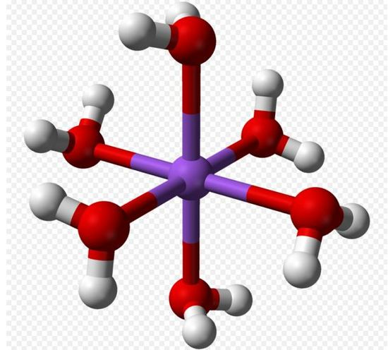
A ligand is an ion or molecule, which donates a pair of electrons to the central metal atom or ion to form a coordination complex. The word ligand is from Latin, which means “tie or bind”. Ligands can be anions, cations, and neutral molecules

Slide 7
Applications of Computational Chemistry
https://en.wikipedia.org/wiki/Computational_chemistry

Slide 8

Computational studies, used to find a starting point for a laboratory synthesis, or to assist in understanding experimental data, such as the position and source of spectroscopic peaks.
Computational studies, used to predict the possibility of so far entirely unknown molecules or to explore reaction mechanisms not readily studied via experiments.
Thus, computational chemistry can assist the experimental chemist or it can challenge the experimental chemist to find entirely new chemical objects.
The prediction of the molecular structure of molecules by the use of the simulation of forces, or more accurate quantum chemical methods, to find stationary points on the energy surface as the position of the nuclei is varied.
Computational approaches to help in the efficient synthesis of compounds.
Computational approaches to design molecules that interact in specific ways with other molecules(e.g. Drug design and catalysis)

Slide 9
Watch:
https://www.youtube.com/watch?v=MA9pnR6VvBw

Slide 10


